Slide 1


Moving the Needle on Performance for Newco
A Preliminary VIEW

Slide 2
Thank-you!

Slide 3
Agenda
Ss
Ss
Ss
Ss
ss

Slide 4
A Summary of Our Data for FDR

Slide 5
Our Initial Questions for FDR
Ss
Ss
Ss
Ss
ss

Slide 6
In general, FDRC is doing ok – our sample store set saw a small amount of net revenue growth in 2019 over 2018.

Slide 7
However, there is a somewhat worrying trend in terms of a decline in customer counts across the system.

Slide 8
The breakfast and dinner dayparts accounted for the bulk of the decline in customer counts.

Slide 9
At the store level, we observe that Store 5 and Store 10 saw the most significant customer count declines.

Slide 10
Store 5 and Store 10 saw particularly significant declines in their breakfast and dinner customer counts.

Slide 11
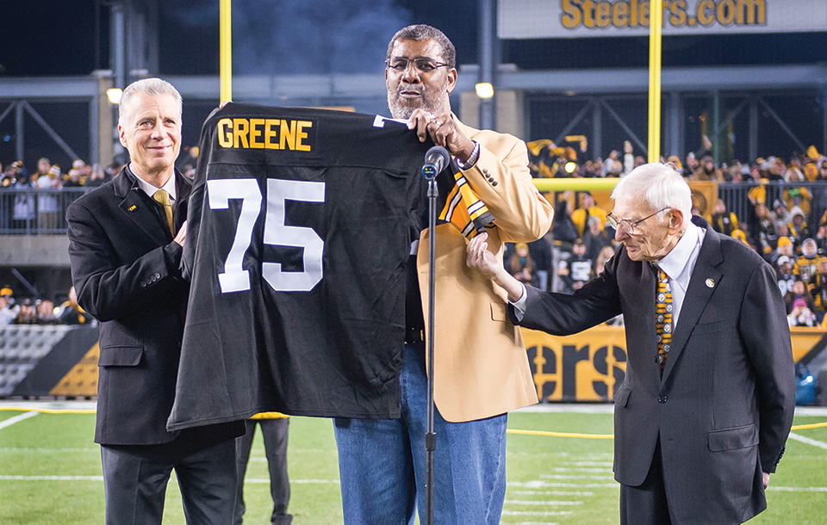
A conversation with Joe Green should likely be a near-term next step.
of the stores that saw declines,
2 stores are within a 3 hour drive
Ss
Ss
s

Slide 12
Caution: There is some indication in the data that price is not fundamentally the issue.
Question: What explains the declining customer counts?
labour shortages
sub-standard or inconsistent service
problems otherwise with how the strategy is being operationalized
a new competitor has arrived on the scene
price – customers in general have become more price sensitive
price – segment(s) of customers have become more price sensitive

Slide 13
Average spend per customer in stores 5 and 10 is tracking system trends - suggesting price is not a driver.

Slide 14
A quasi-price sensitivity model also provides validation that price is not a major contributor re customer counts.

Slide 15
The Decision Inventory as a Tool for Uncovering Opportunities.

Slide 16
Beyond Joe’s issues, a five-point framework might be helpful in uncovering further pricing-related opportunity.
Eee
Dd
D
D
Dd
D
Dd
D
Eee
Dd
D
D
Dd
D
Dd
D
Eee
Dd
D
D
Dd
D
Dd
D
Eee
Dd
D
D
Dd
D
Dd
D
Eee
Dd
D
D
Dd
D
Dd
D

Slide 17
Forecasting: The limited amount of data and the small amount of signal in the data make forecasting a challenge.
Some opportunities:
further develop the business problems that a better forecast might address
data for more months
resampling what we have as weekly data
looking beyond the system-wide revenue level
model evaluation
with more signal, look at time series models beyond seasonal naive
looking at SARIMAX and other modeling-types that factor in exogenous variables
approaches that include and utilize uncertainty

Slide 18
What would RML be getting with me?
someone who will roll up the sleeves and do the work
someone with some technical skills
a proven mentor of developing talent
maybe: RML’s next conjoint specialist
a passionate contributor to RML’s intellectual capital
an able business developer – someone who can bring in some work

Slide 19
Your best quote that reflects your approach… “It’s one small step for man, one giant leap for mankind.”
- Neil Armstrong

